Slide 1
Communication Challenges with Colleagues
Pediatric Academic Half-Day
March 8, 2018

Slide 2
Objectives – Communication Series
Through completion of these workshops over a three-year cycle, pediatric residents should be able to:
Feel more confident in addressing more challenging communication situations with patients, families, and colleagues
Describe and utilize a various communication skill sets during their training and future practice
List communication strategies that will better facilitate interactions in the following situations:
  Breaking bad news to patients and families
  Disclosure of medical error (and near-misses) and apology
  Communication challenges
    with colleagues and other staff (failure to fulfill one’s duties, engagement in inappropriate behaviours)
    with families (differences in care wishes, leaving AMA)
  Discussion around end of life care including DNR planning
  Cultural competency (how to recognize and acknowledge differences in cultural beliefs/values, non-traditional medicine, how to interact with translation services, etc)
  Communication with adolescents and adolescent issues including sex/sexuality, transgender medicine, addressing obesity, and tips on motivational interviewing

Slide 3
Communication Strategies – the Basics
In person, where able
Identify common goals
  Optimal patient care
  Reducing uncertainty
Being clear with limitations (i.e. your boundaries for safety and/or knowledge)
Keep communication lines open

Slide 4
Tools & Strategies Summary
BARRIERS
Inconsistency in Team Membership
Lack of Time
Lack of Information Sharing
Hierarchy
Defensiveness
Conventional Thinking
Complacency
Varying Communication Styles
Conflict
Lack of Coordination and Followup With Coworkers
Distractions
Fatigue
Workload
Misinterpretation of Cues
Lack of Role Clarity
TOOLS and STRATEGIES
  Communication
  SBAR
  Call-Out
  Check-Back
  Handoff
  Leading Teams
  Brief
  Huddle
  Debrief
  Situation Monitoring
  STEP
  I’M SAFE
  Mutual Support
  Task Assistance
  Feedback
  Assertive Statement
  Two-Challenge Rule
  CUS
  DESC Script
OUTCOMES
Shared Mental Model
Adaptability
Team Orientation
Mutual Trust
Team Performance
Patient Safety!!

Slide 5
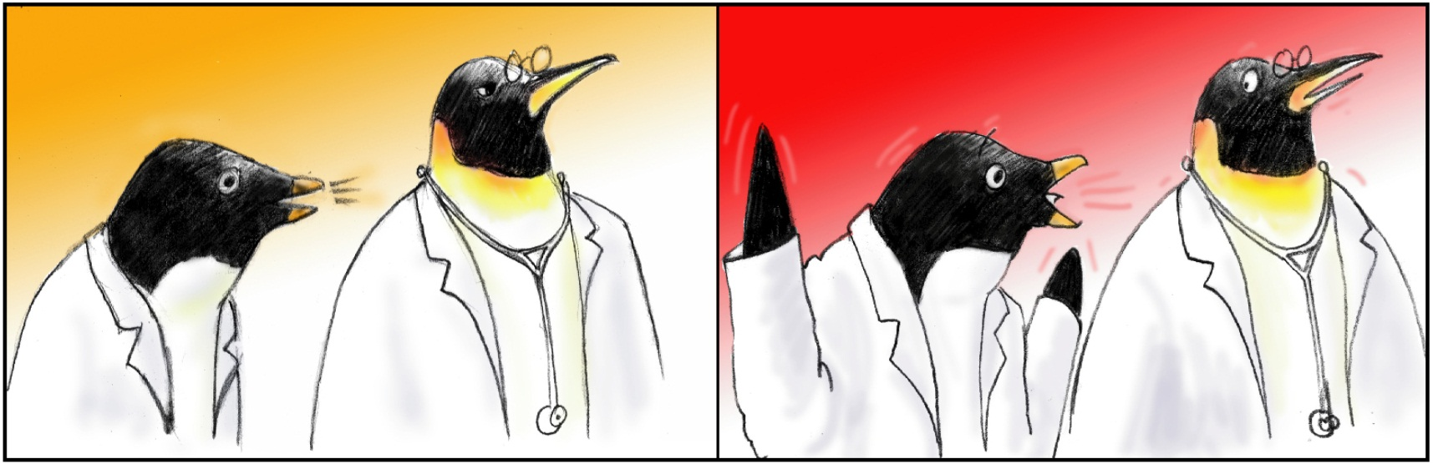
Two-Challenge Rule
1
2

Slide 6
Two-Challenge Rule
Invoked when an initial assertion is ignored…
It is your responsibility to assertively voice your concern at least two times to ensure that it has
been heard
The member being challenged must acknowledge
If the outcome is still not acceptable
  Take a stronger course of action
  Use supervisor or chain of command

Slide 7
Two-Challenge Rule cont.
Empower any team member to “stop the line” if he or she senses or discovers a breach of safety.
This is an action never to be taken lightly, but it requires immediate cessation of the process and resolution of the safety issue.

Slide 8
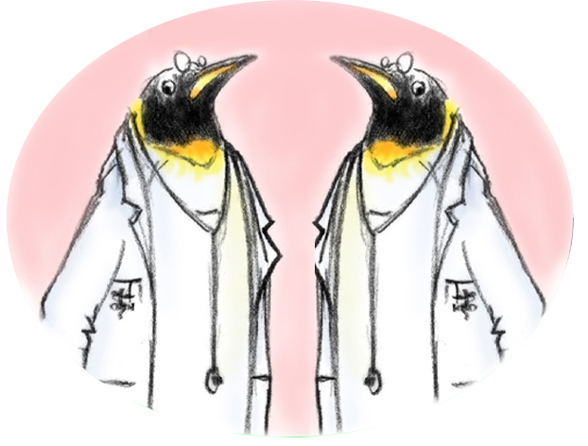
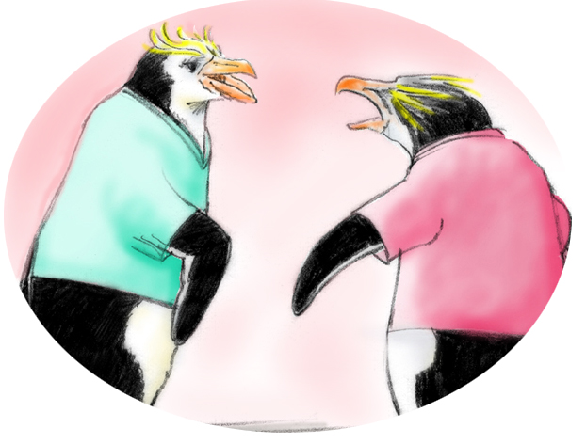
Conflict in Teams
Interpersonal Conflict
(Hostile and harassing behavior)
DESC Script
Informational Conflict
(We have different information!)
Two-Challenge Rule

Slide 9
Conflict Resolution
DESC Script
A constructive approach for
managing and resolving conflict
  D—Describe the specific situation
  E—Express your concerns about the action
  S—Suggest other alternatives
  C—Consequences should be stated

Slide 10
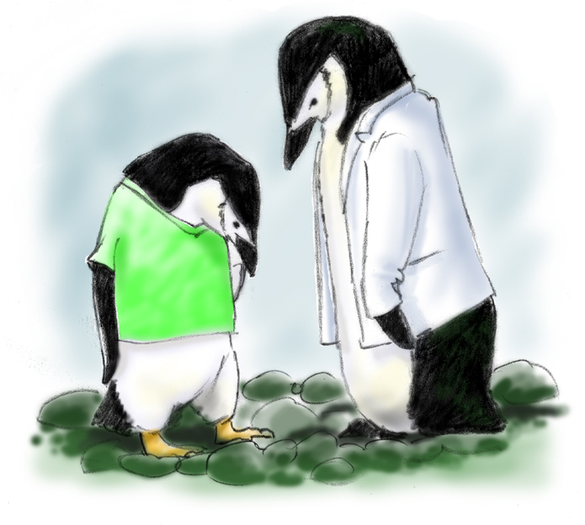
DESC-It
Let’s “DESC-It!”
Have timely discussion
Work on win-win
Frame problem in terms of your own experience
Choose a private location
Use “I” statements; avoid blaming statements
Critique is not criticism
Focus on what is right, not who is right

